Slide 1
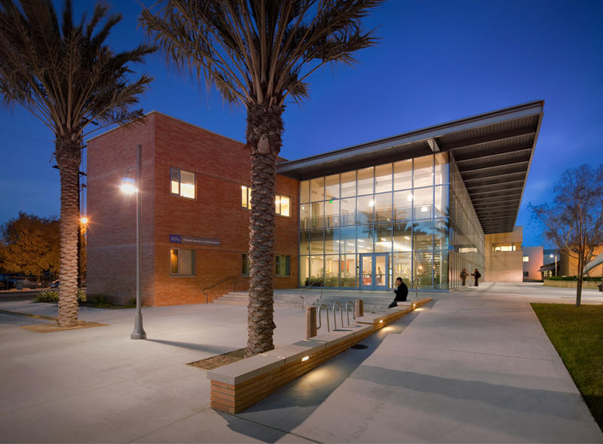
First Year Seminar
CAMPUS RESOURCES

Slide 2
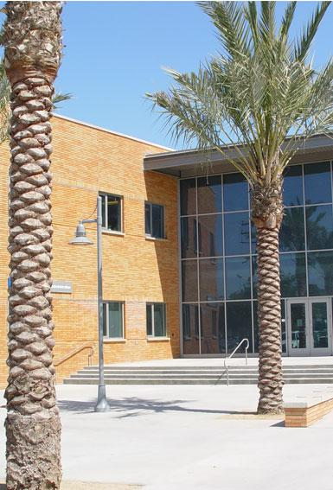
Follow Up
Planner Checks!
Grad Guru Download
Student Email

Slide 3
Umoja is a community & critical resource dedicated to enhancing the cultural & educational experiences of African American & other students.
Counselor: Brittany Gray
Location: SEAHAWK CENTER 204
Community - Campus Resources

Slide 4
Community - Campus Resources
Puente is a cohort program that focuses on transferring Latino students to four-year universities
Counselor: Dr. Jassiel Dominguez
Location: SSA Room 103J

Slide 5
DREAMERS is a program committed to creating access & increasing retention of undocumented students at LAHC. The goal is to increase awareness of programs & resources available to undocumented students.
Counselor: Jamie
Location: SEAHAWK CENTER 204
Community - Campus Resources

Slide 6
Counselor: Leland Simpliciano
Location: https://lsimpliciano.youcanbook.me/
Community - Campus Resources
APASS provides Asian Pacific American students opportunities for academic achievement, cultural awareness, & leadership development.

Slide 7
CHAMPS- Challenging Athlete’s Minds for Personal Success
Our mission is to enhance the quality of the student-athlete experience within the context of higher education.
Contact: Leslie Trujillo, PE 149

Slide 8
Life Skills Center
Sound Mind, Sound Body, Sound Future
Provides mental health counseling & related services, enabling students to meet their personal, emotional & environmental challenges that can interfere with a students academic success. The LSC teachers Life Skills which improve student management of college demands & equips students to more readily handle stressors.
Location: Technology Building Room 118

Slide 9
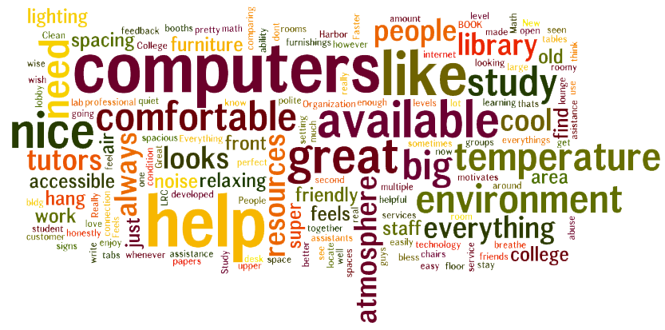
Library/Learning Resource Center LLRC:
Free Tutoring!
https://www.lahc.edu/lrc/getatutor.html
Notes:
One of the best places to study as well

Slide 10
General Counseling Center
What they do:
Make an Educational Plan
Address Probation Requirements
Talk about Transfer
Talk about Degree Options
Clear Prerequisites
Drop in Questions

